Slide 1
IEEE Project Competition
Week 5: BOMs and Project Management

Slide 2
Overview
This session, we will go over the process for writing and submitting your bill of materials to have parts ordered.
We will also go over methods of project management and introduce them.
We will highlight how to create a GitHub account if your project requires.
We will then end the presentation and assist in what your project needs.
Note: No soldering workshop, go to Anh’s he's a pretty cool guy.

Slide 3
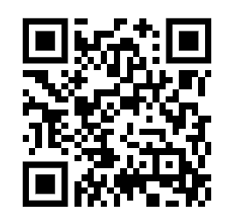
Attendance

Slide 4
Change your discord user to your:
First Name and last initial if you prefer.

Slide 5
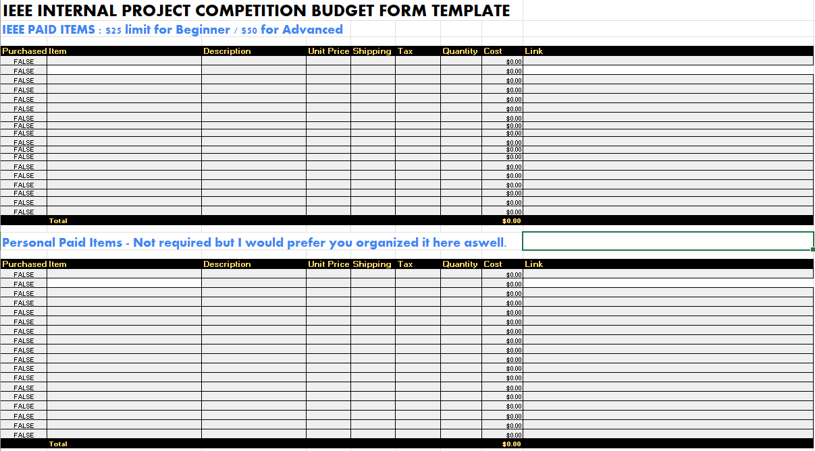
BOM Template Guide (Available in discord #learning hub)

Slide 6
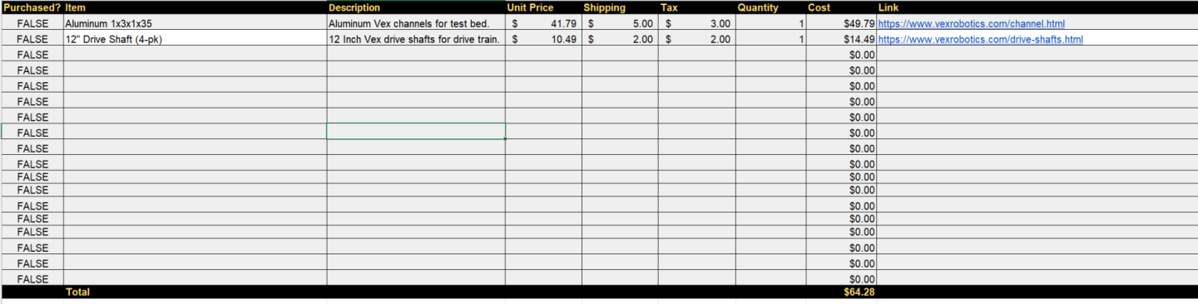
Navigating the BOM!?!
Quantity amount, can put multiple.
Exclude shipping unless PCB.
Description.
Don’t worry this, we will handle it.
Simple name.
Price.
Exclude tax because nonprofit.

Slide 7
Navigating the BOM!?!
Cost with total.
A link that works! please :)

Slide 8
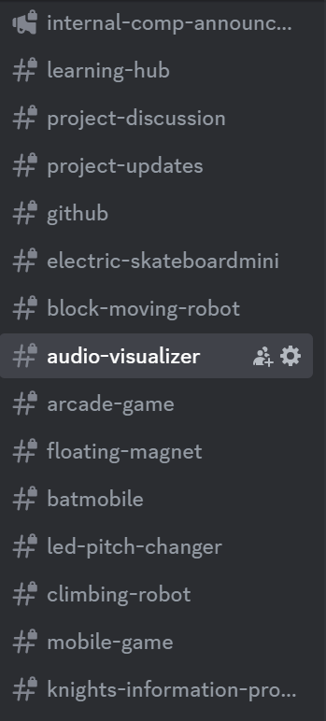
Navigating the BOM!?! - Submission
Submission in discord
group channels

Slide 9
Navigating the BOM!?! - Due Date?
November 30th, we will be checking on progress throughout so be on the lookout!

Slide 10
Questions so far?

Slide 11
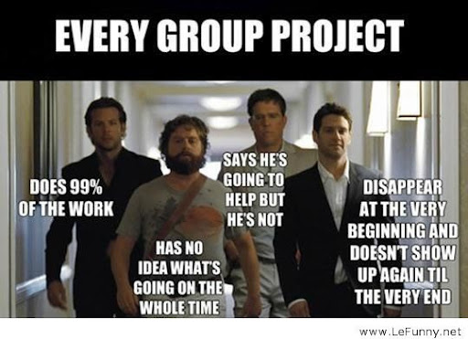
Project Management - What is it? Why it matters?
Project management is essential in the engineering industry to organize, plan, and execute projects efficiently.
It ensures that objectives are met within scope, time, and budget, while maintaining quality standards.

Slide 12
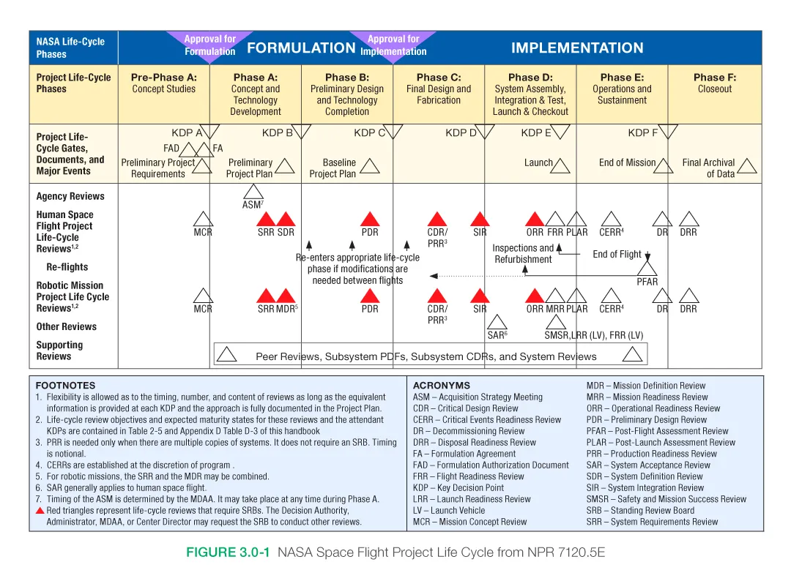
Project Management - Industry
NASA while complicated has their own project lifecycle implementation.
Similarly any company such as Space-X, Lockheed all have project lifecycles.
NASA Project Life Cycle

Slide 13
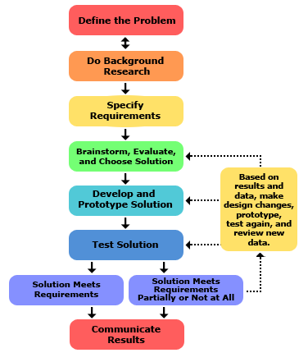

Slide 14
Project Management - IEEE UCF
For IEEE projects we use Bi-Weekly Meetings, meeting minutes and follow a general structure for meeting times/establishing goals/budget request process.
For internal project competition it will be more straightforward.

Slide 15
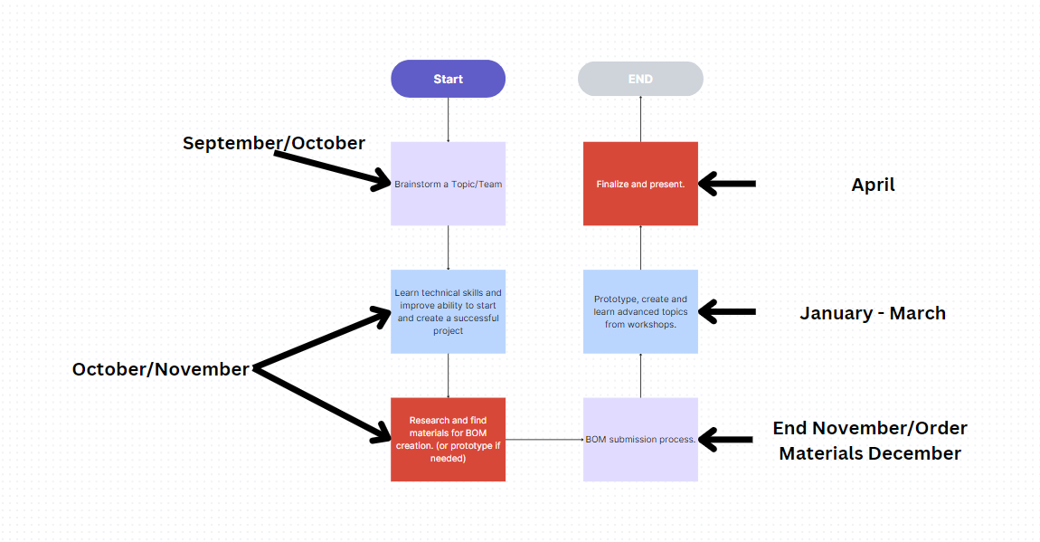
Our Metric

Slide 16
Tips and Tricks
Research! Watch youtube videos learn about how something similar if not the same is being made.
Look in the description of videos for part numbers and item links.
Update the excel sheet for what you find.
Talk to us and ask questions! We are knowledgeable on these things.
Don’t rush it, BOM creation is also a technical skill!
Feeling lost ask us, AI or just browse a search engine for ideas on where to start.
Keep accountable of each other the more work you put in the more you get out and the more comfortable you are in industry.

Slide 17
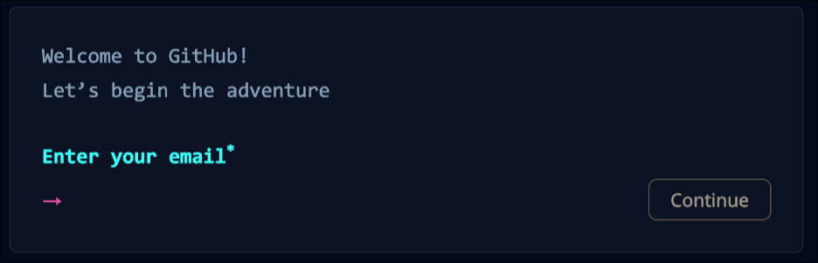
But How Do You Make GitHub
Go to https://github.com
Do what it says

Slide 18
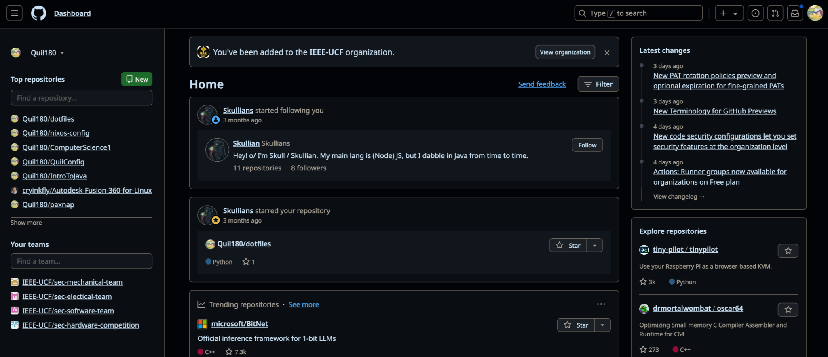
But what in the world is this???
News from other Repositories/Github
Your Repositories/Projects your involved in.
Updates space

Slide 19
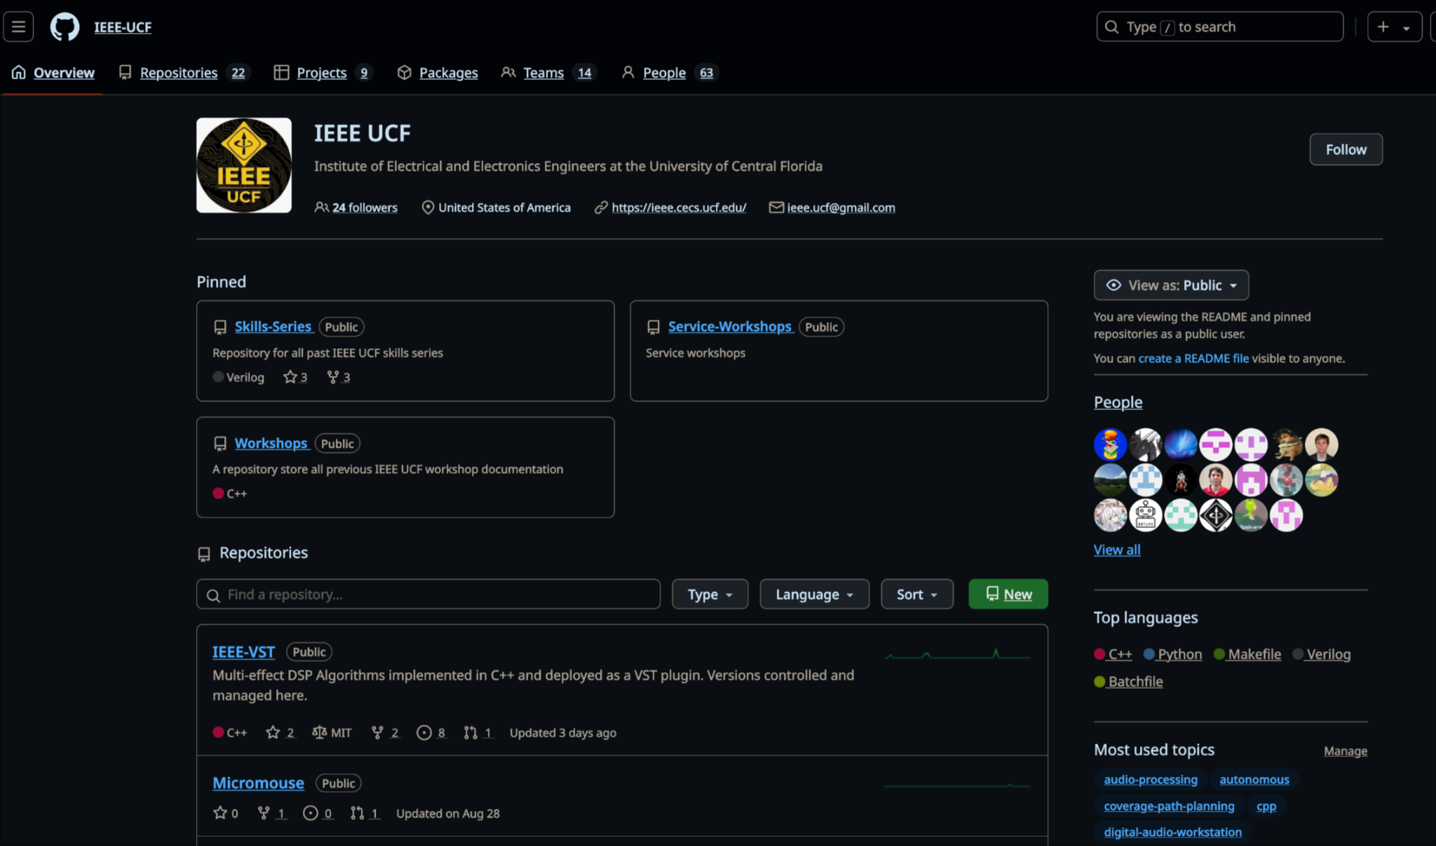
What about when in a Organization/Repo Group?
Repositories means categories, with projects being made up of repositories.

Slide 20
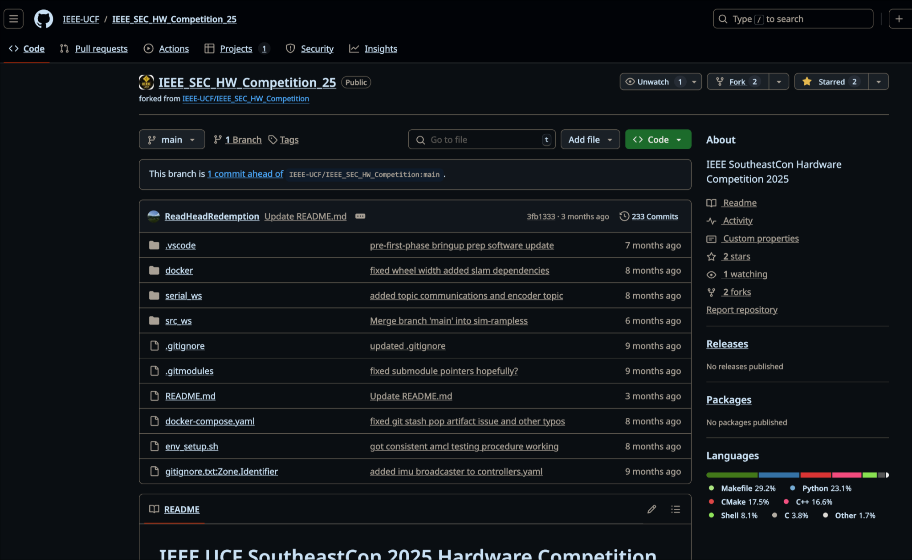
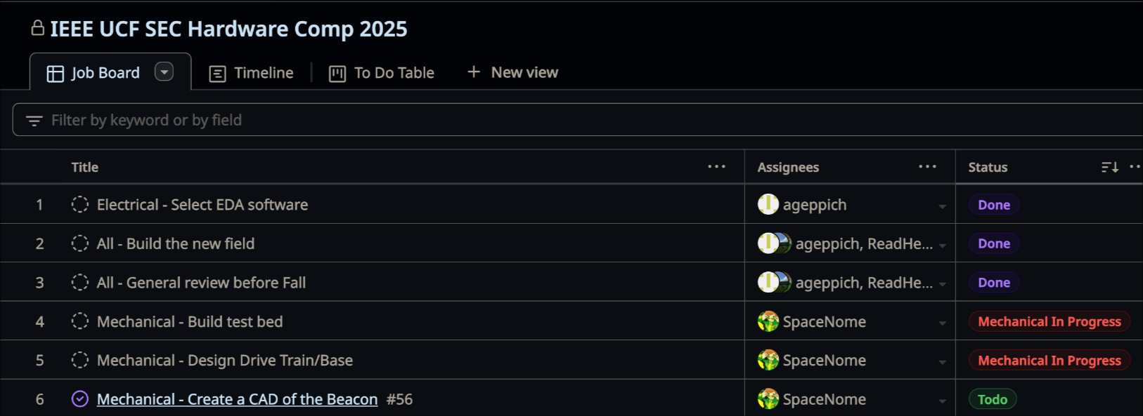
Repositories Page
Pull Requests are requests made by others to change code/files in the repo.
You can see the files in the repository.
The projects tab shows tasks and their progress (like Trello, if you’re familiar with it)

Slide 21
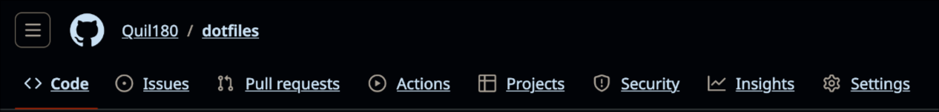
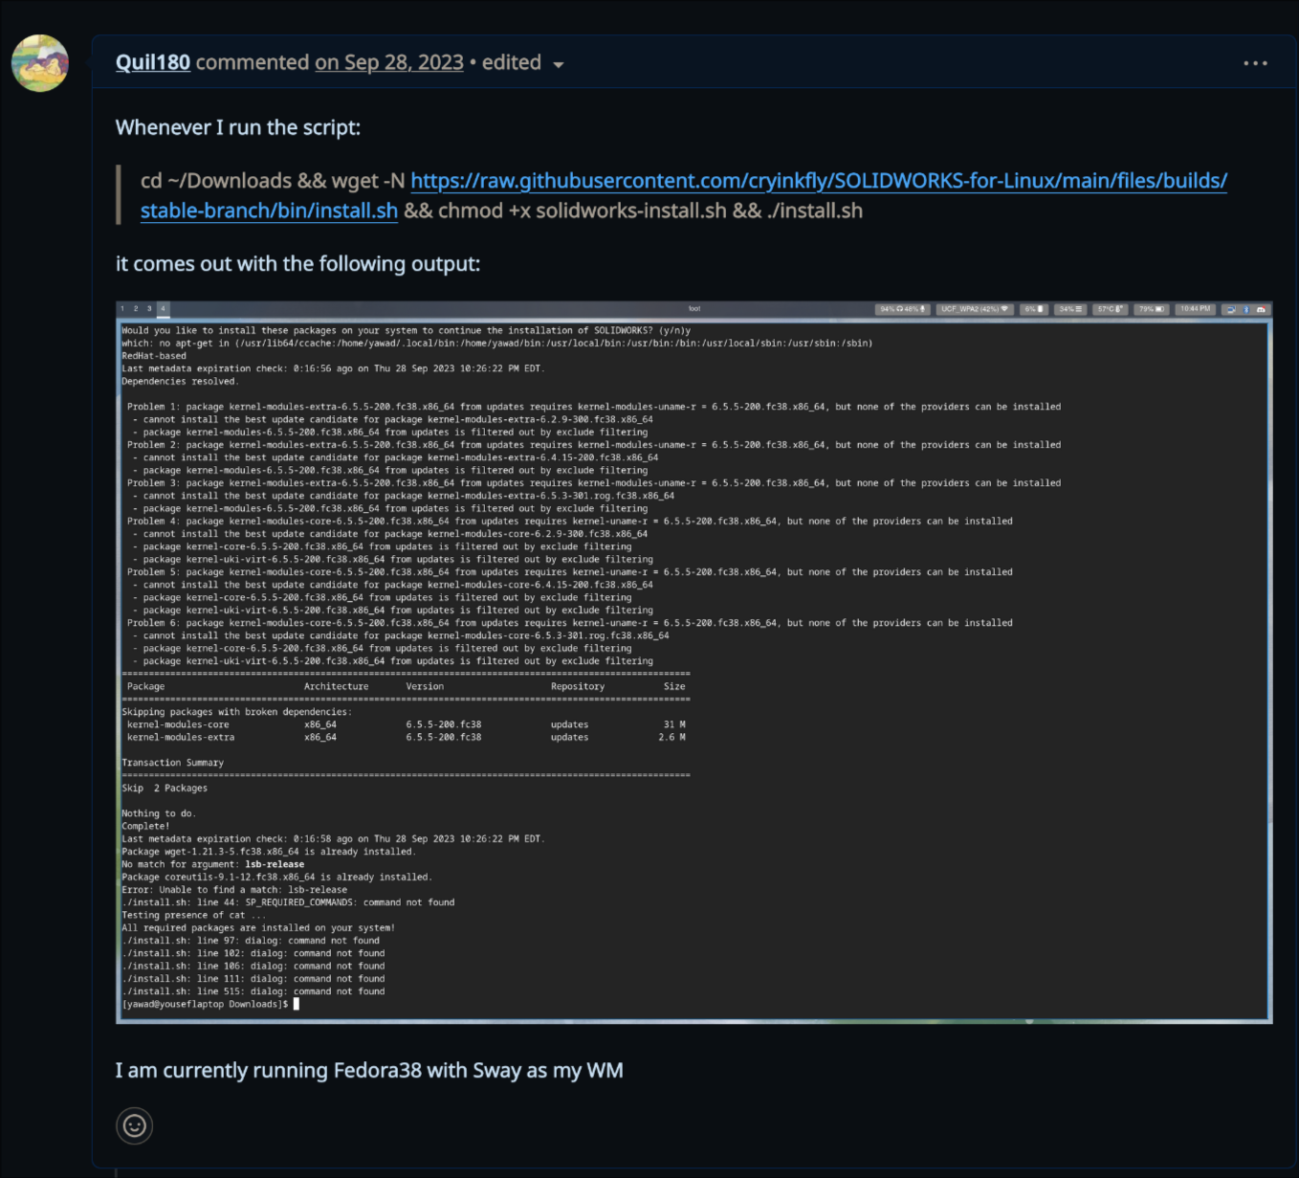
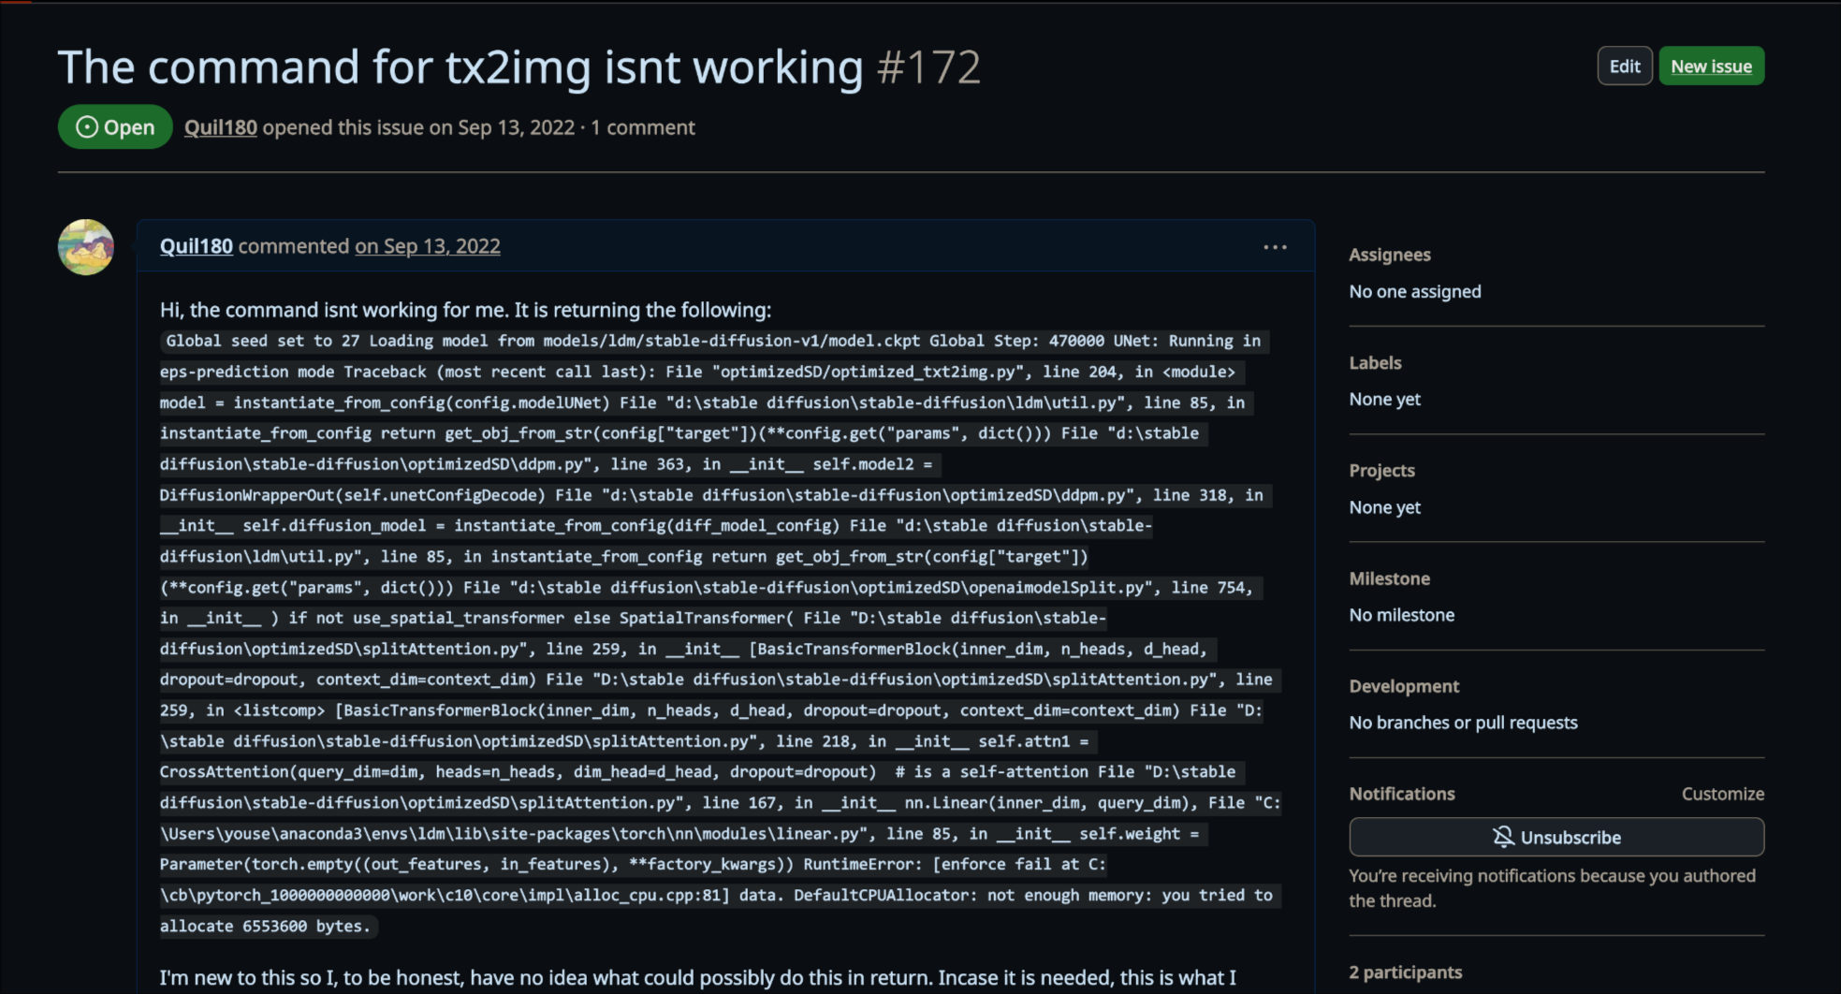
If you’re in a public repository, you’ll have more tabs
The issues tab is for users of the repository (such as with Linux), to post issues on how the program/code is breaking when it’s used.
Example Issues in other repositories

Slide 22
But how do you upload to Github?
You have 2 Options (of which will be covered in the Git/Github Workshop):
Use GitHub Desktop (for a GUI approach)
Use Git CLI for a (terminal/console approach)
Both have pros and cons:
GitHub Desktop is more user friendly but more limited.
Git CLI is harder to use but faster and has more freedom.

Slide 23
Timeline and Important Dates
Weekly Meetings - Estimated Timeline
Week 1 | Week 2 | Week 3 | Week 4 | Week 5 | Week 6 | Week 7 | Week 8 | Week 9 | Week 10
Introduction | Microcontrollers - Erik | Fusion 360/Solidworks - Matias | KiCAD -Tino | General Project Management Skills/ Github/ BOM’s | Technical Assistance Focused | Git and GitHub Workshop | Technical Assistance Focused (Veterans Day) | Intro to Sensors | Winter Break (BOMs due 30th Nov)

Slide 24
Reminders
Please check discord channels for your respective project.
Recruit if you want! The more the more you may learn and get out of the project!
Next week technical assistance focused workshop, week after is Git/ GitHub workshop.
Talk to us beforehand if you think your design will require a custom PCB.
GBM this week!
BOM’s due November 30th.

Slide 25
Finalized Teams
Electric Skateboard (Mini) - Beginner | Block Moving Robot - Advanced | Audio Visualizer - Beginner (individual) | Arcade Game - Advanced (individual) | Floating Magnet - Beginner (Individual) | Batmobile - Beginner | LED Pitch Changer - Beginner | Climbing Robot - Beginner | Mobile Game - Beginner | Knightboy- Advanced
Evan Eichholz, Bree | Eric Segrest, Abdiel, Mike (maybe) | Alexander | Aldem | Joshua Guo | Amy Diaz, Liani Garcia, Jennifer | Landon Luke, Ryan Moran, Samuel Hustin | Viviana, Frankey, Rolando, Keya | Joshua, Jacob, Jason | Scott …
Airpodsred, breemars56 | MrE9000, thebackdimple , _dasanii | limes1 | syndric | tallasian0281 | Tedpluto, lenedinal | Landonluke, rmoran24 | LanceEvo,Madeem, amnotkt | Espial7, Funnmy, jasr321 | .planky.

Slide 26
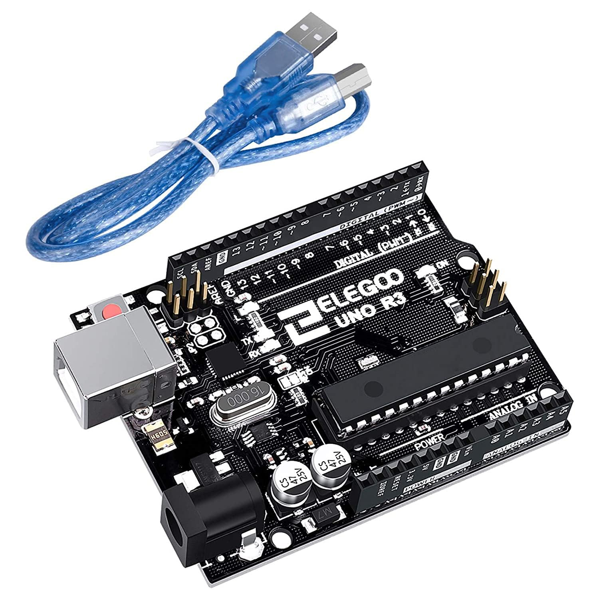
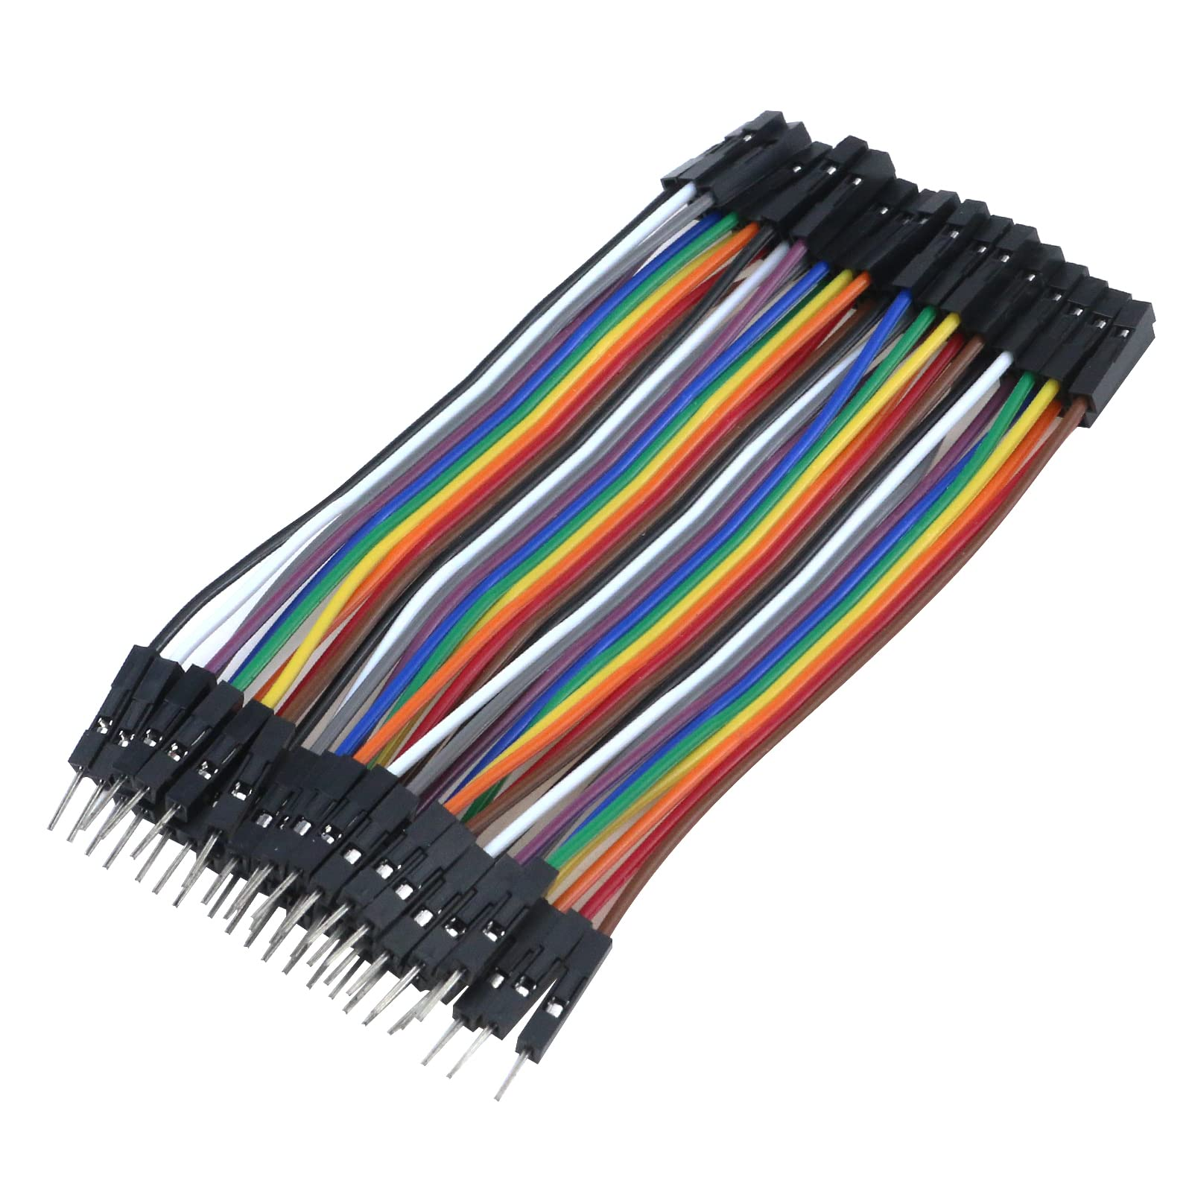
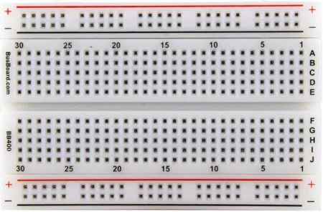

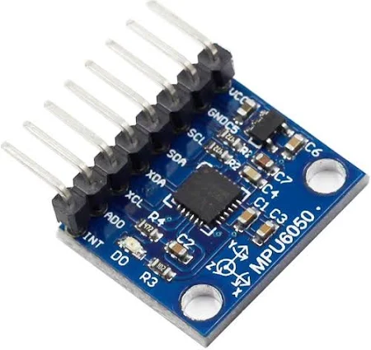
To get your started here are some suggestions:

